Slide 1
Building Offensive Tools with Nim
Webinar Series
D’ZIT 59
Satria Ady Pradana

Slide 2
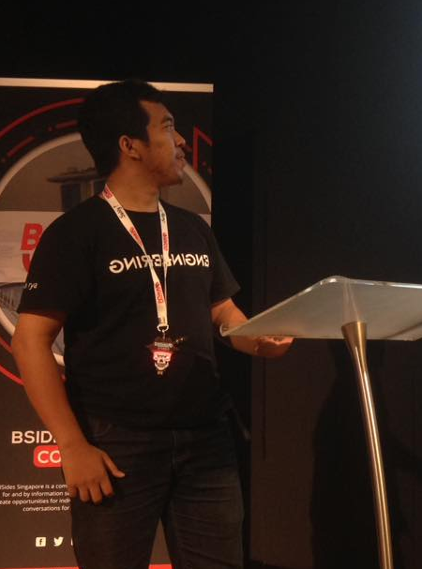



Who am I?
Satria Ady Pradana
Ordinary Cyber Security Guy
Instructor at Archonlabs SSD
Penetration Tester, Red Team, Adversary & Breach Simulation
Community Leader of Reversing.ID
Love Low-Level Stuffs
xathrya
xathrya
@xathrya

Slide 3
Why Nim?
Simple and clean structure
Python-like Syntax and C-like performance
Rich and open source environment.
Efficient, expressive, and elegant.
Easy cross-compilation
Compiles to C/C++, JavaScript
Easy to use C libs and Win API

Slide 4
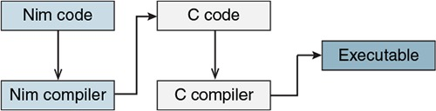
Nim Compilation Process

Slide 5
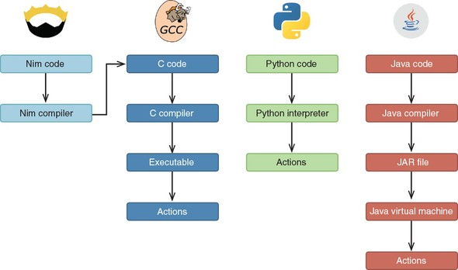
Nim vs Others

Slide 6
What’s here?
Key point of NIM programming.
Building block for cyber security activity.

Slide 7
Our Setup
Kali Linux 2021.1 (VM)
Nim 1.4.2
Windows 10
Nim 1.4.8

Slide 8
References
http://nim-lang.org
https://github.com/xathrya/nim-workshop
https://github.com/byt3bl33d3r/OffensiveNim
https://github.com/VPashkov/awesome-nim

